Slide 1
ABAP Part II
Lesson 10: ALE IDOCS

Slide 2
Lesson Objectives
After completing this lesson, participants will be able to -
Get familiarized with the jargons used in ALE, IDOC & EDI.
Know the concept of ALE and Idocs.
Know more about Idoc structure and its role in Data communication
Learn basic Outbound Processing of IDoc.
Learn basic Inbound Processing of IDoc.
Have a Quick Introduction to EDI.

Slide 3
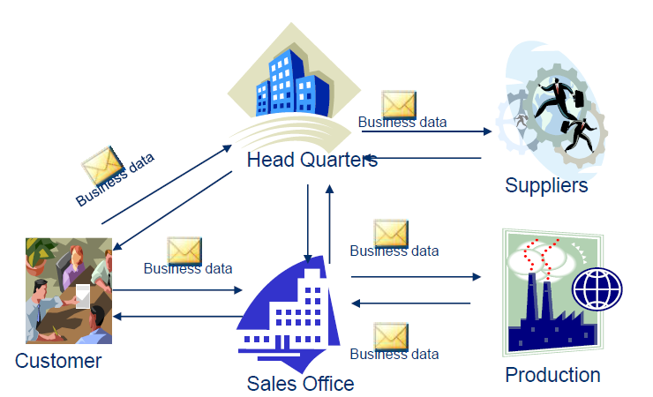
Business Requirement for Integration
A normal business structure comprises of an organization with multiple offices spread across different countries. They do business with customers and vendors spread across different locations.
The organization sends business data to its different offices as well as to its customers and vendors.

Slide 4
Business Utilization
SAP Business units (Sales Unit & production Unit) can use ALE for internal data exchange.
ALE is SAP Technology to send and receive business data in SAP Systems.
Container for the data is IDoc.
When communicating with Business Partners (customers/suppliers on non-SAP platforms) SAP business units can exchange data through EDI using IDocs.

Slide 5
What types of data Exchanged?
Transaction Data
Sales Order, Purchase Order, Invoice etc.
Master Data
Material, Customer, Vendor, etc.

Slide 6
IDoc – Intermediate Document
IDoc is an Intermediate document that holds application data.
A container used to exchange data
It is independent of the complex SAP structure to store data.
It serves as the vehicle for data transfer.
IDoc Type defines the structure and format in which the data is exchanged.
It is similar to a structure in SAP
IDoc data is an instance of IDoc Type
IDoc acts as a standard SAP interface to exchange business data through ALE.

Slide 7
IDoc – Intermediate Document
From an SAP system, an IDoc can be sent to and received from
An SAP R/3 system
An SAP R/2 system
An EDI subsystem
Any third-party application software
Segments: . Idoc data is arranged in Rows, The rows make up segments of an Idoc. Each segment consists of fields/segments. Fields can contain data.

Slide 8
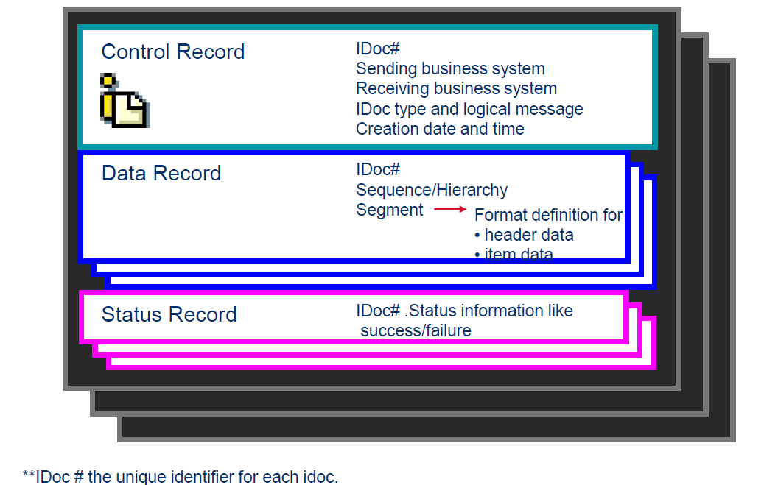
IDoc Components

Slide 9
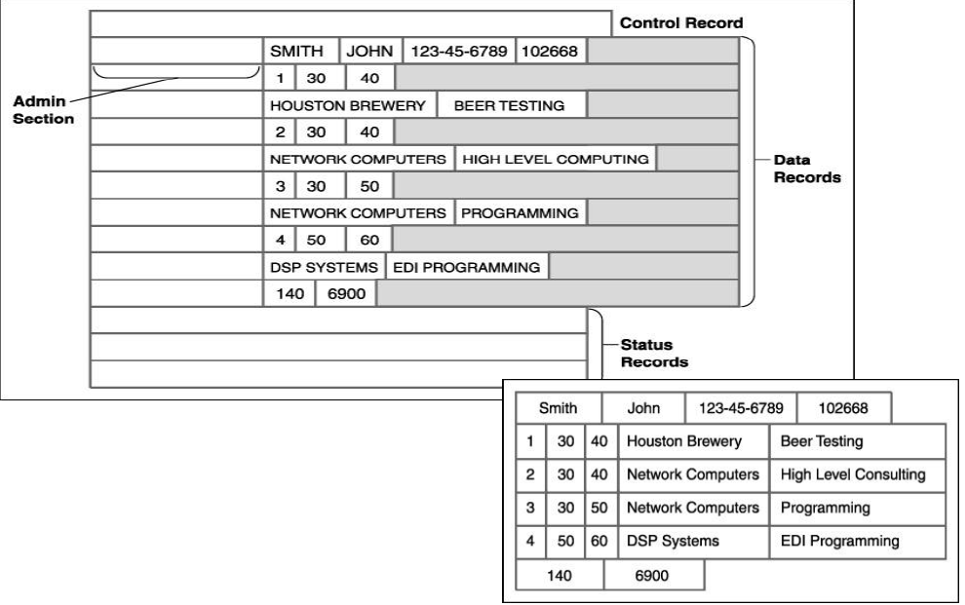
IDoc – Intermediate Document
IDoc is an instance of IDoc type. It contains actual data .

Slide 10
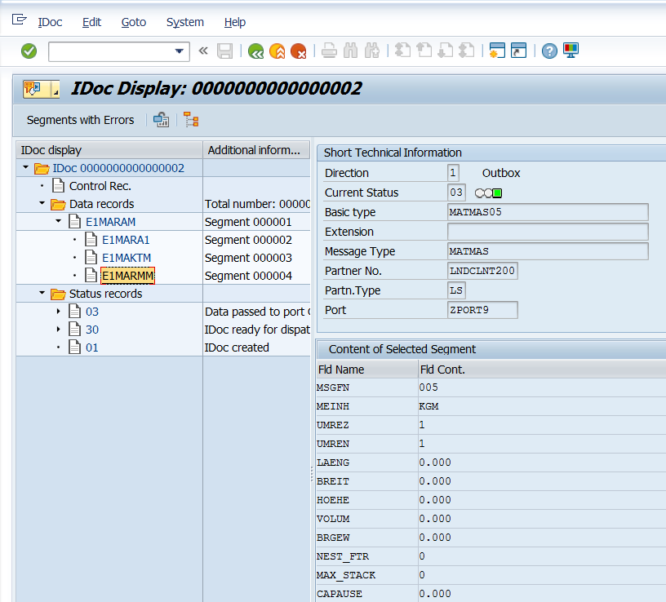
IDoc
Data Records constitute of segments with a sequential segment number, a segment type description and field containing the actual data of the segment (to a max of 1000 bytes)

Slide 11
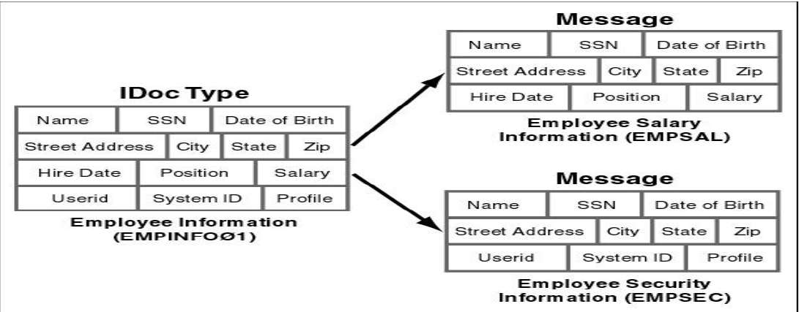
Message Type
A message type represents a specific type of document that is transmitted between two partners. Messages will be logically related.

Slide 12
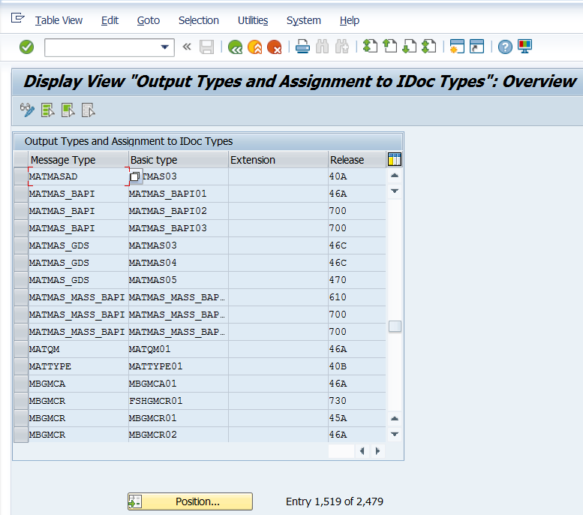
Message Types
WE82

Slide 13
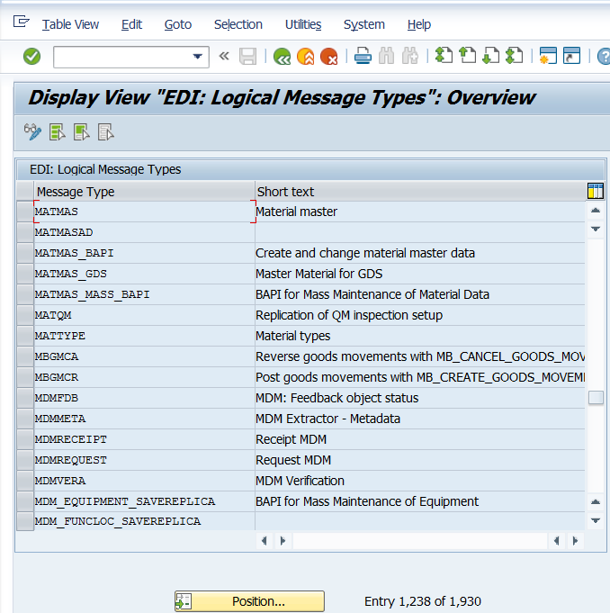
Message Types
WE81

Slide 14
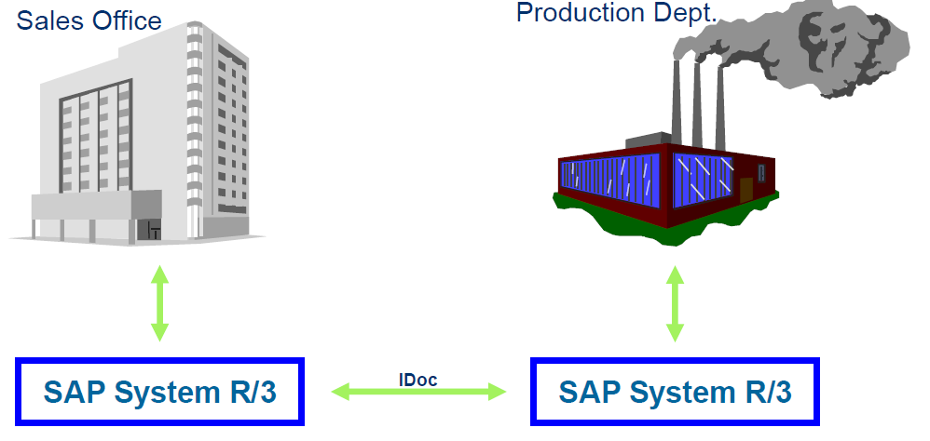
ALE Scenario
Typically ALE used when data needs to be exchanged within the company. For example between Sales Office and Production Department.

Slide 15
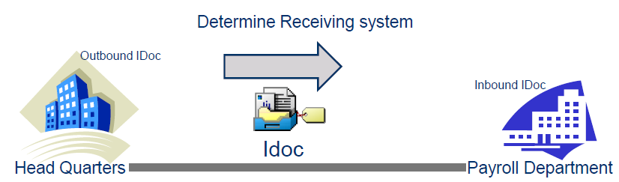
ALE – Application Link Enabling
Application link enabling is SAP’s terminology, used to integrate business processes between R/3 Systems and non-R/3 systems.
ALE is the technology used to transfer business data between different systems using IDocs.
IDoc is the container for the business data and ALE is the technology which builds the road for data transfer.
For example to send Employee Data to Payroll department from HO, HO will populate Employee detail into the EMPINFO01 format(IDoc). ALE settings will determine who is the receiver, how to connect to the receiver and transmits the data.

Slide 16
Services involved in ALE
ALE comprises of three layers:
Application Services
Distribution Services
Communication Services

Slide 17
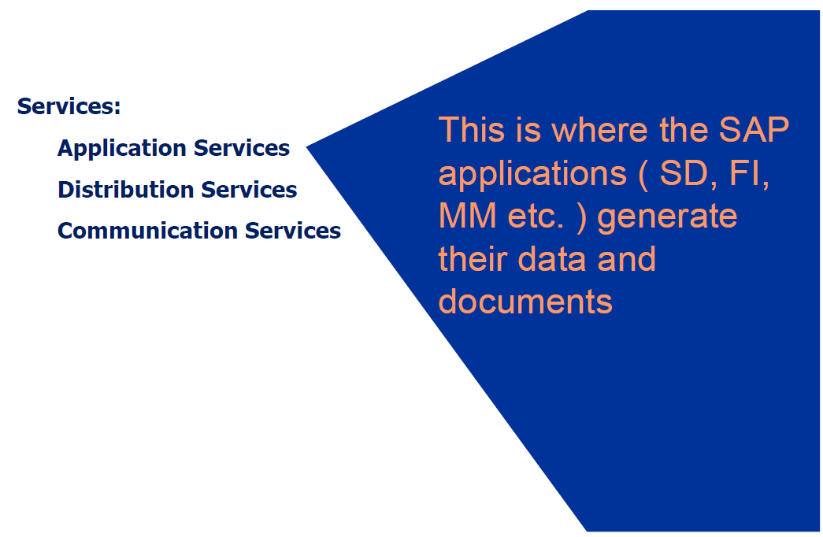
Application Services

Slide 18
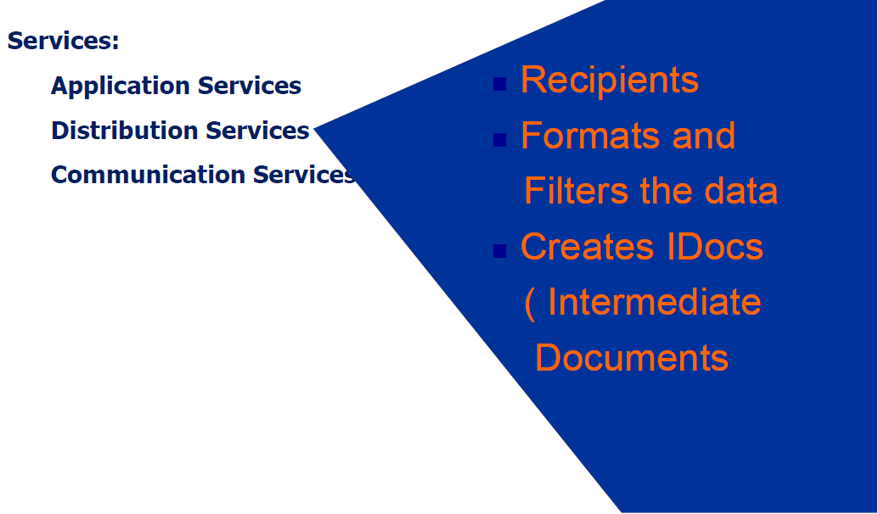
Distribution Services

Slide 19
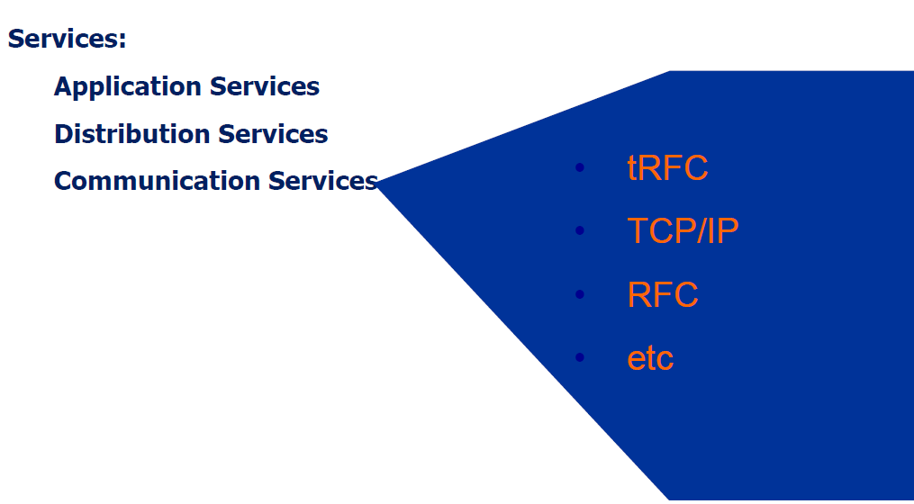
Communication Services

Slide 20
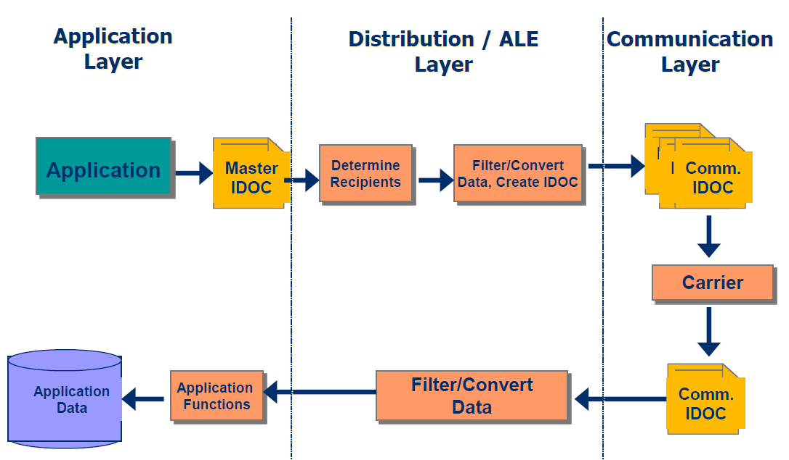
To Sum-Up

Slide 21
Advantages of ALE
ALE business process is used for following distribution of tasks:
1. Synchronizing customizing data between systems.
2. Master data distribution
3. R/2 Connection
4. External system connection
ALE Model is independent of the participating application systems.
Technology supports guaranteed delivery.
Ensures backward compatibility of messages exchanged between systems.
E.g. Version Compatibility.
Reduced Processing Cycle time
Reduced Paperwork
Reduced Cost
Standard means of communication

Slide 22
Basic components Involved in ALE Model Setup
The below are the basic configuration steps involved in exchanging the business data between two systems in distribution service layer.
Logical Systems ( TCode – SALE )
R/3 Clients involved in data exchange ( TCode – SALE )
RFC Connections ( TCode – SM59 )
Distribution Model ( TCode – BD64 )
IDoc + Message Type ( TCode – WE82 )
Partner Type / Partner Profiles ( TCode – WE20 )
Ports ( TCode – WE21 )

Slide 23
Logical Systems – Partner Types
Logical System is a name given to uniquely identify, the systems involved in data exchange.
Logical Systems (LS) represent R/3 or external systems in the SAP R/3 environment for the distribution of data.
•A client of an SAP instance is represented by a logical system in the ALE context. This logical system will act as sender or receiver of Idocs.
Partner Type - Partner type are used to classify the business system.
Ex: Logical System (LS) –for other SAP clients,
Customer (KU), Vendor (LI) etc..

Slide 24
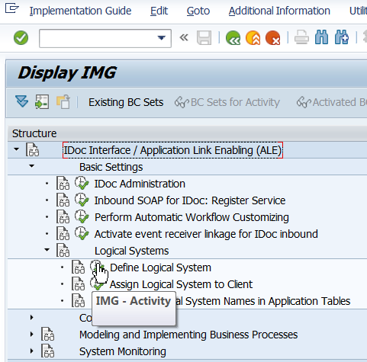
SALE
SALE is Tcode that is used for all ALE customizing

Slide 25
RFC Destinations
In ALE the systems communicate with each other through Remote Function Calls (RFC).
An RFC destination contains technical details about other SAP systems.
E.g.: If EC1 wants to communicate with BW.
In EC1 system we will define an RFC destination for BW.
This will contains technical details about BW system.
For ALE you will create RFC destinations for all participating systems (which is a part of communication services layer in ALE).
Tcode - SM59 / SALE ->Basic Settings ->Communication
->Create RFC Connections

Slide 26
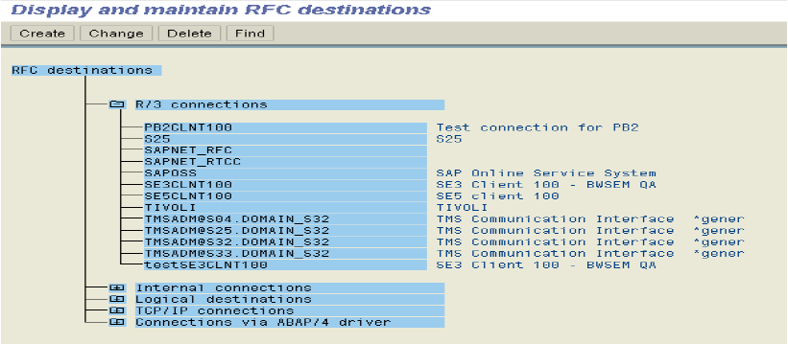
RFC Destinations
For ALE we choose to create an RFC destination of type R3/ABAP. This type of RFC is used when we want to connect to other R3 systems as this protocol (tRFC) is only understood by SAP systems.
In RFC destination details like target host IP address , system number , user logon data are provided.

Slide 27
Distribution Model
A model that describes the ALE message flow between logical systems.
Applications and the ALE distribution service layer use the model to determine receivers and to control the data distribution.
Relationships between logical systems, message types are defined in the distribution model.

Slide 28
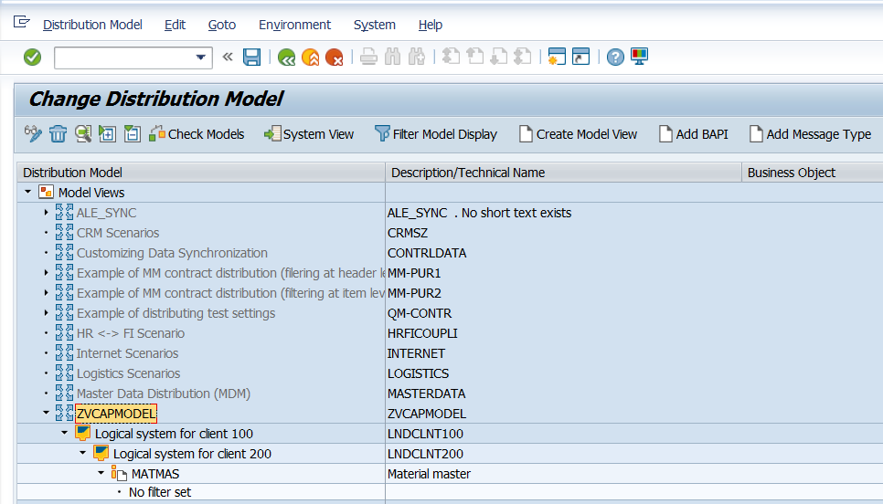
Distribution Model
Tcode – BD64
Sender Logical System – LNDCLNT100
Receiver Logical System – LNDCLNT200
Message Type – MATMAS

Slide 29
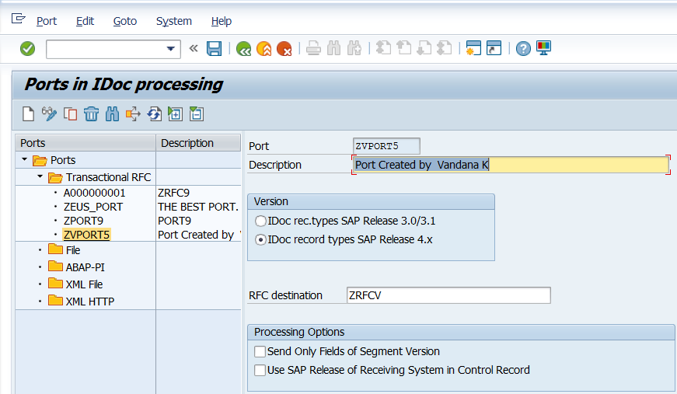
Ports
You specify the technical characteristics of the link between the SAP System and the other system in the port definition.
The following port types are supported:
Transactional RFC
File
XML File
We can create PORTS in Tcode WE21.

Slide 30
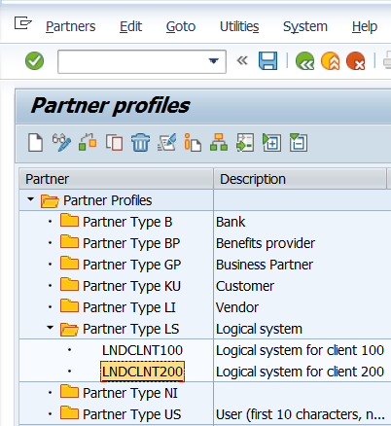
Partner Profiles
The partner profile contains parameters that define the electronic interchange of data with a partner via an IDoc interface.
In SAP, all partners systems involved in a distribution model have a profile. There exist several profile types such as customers profiles, vendors profiles,
In most cases partners profiles are created using a generic Logical System (LS).
TCODE WE20

Slide 31
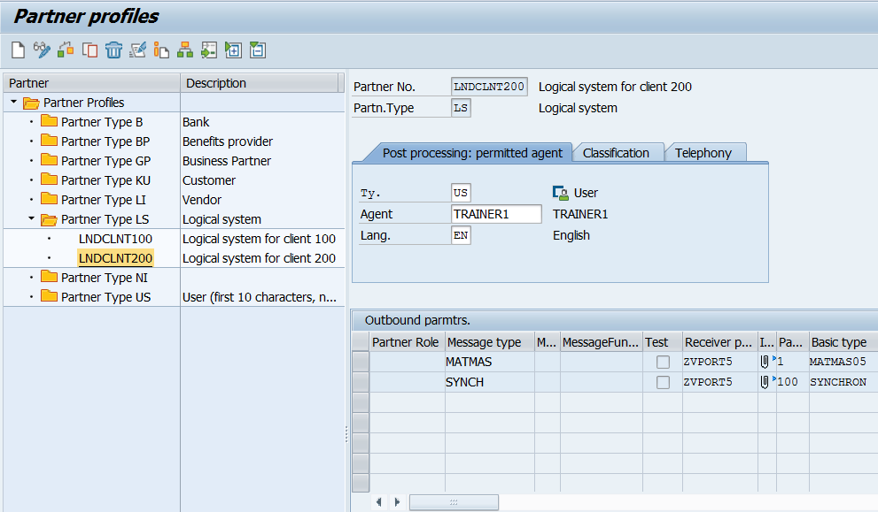
Partner Profiles
A partner profile is used to determine a lot of important settings that will be involved in the data transfer. These settings vary depending on the role of the partner system (sender / receiver) and are defined per message type.

Slide 32
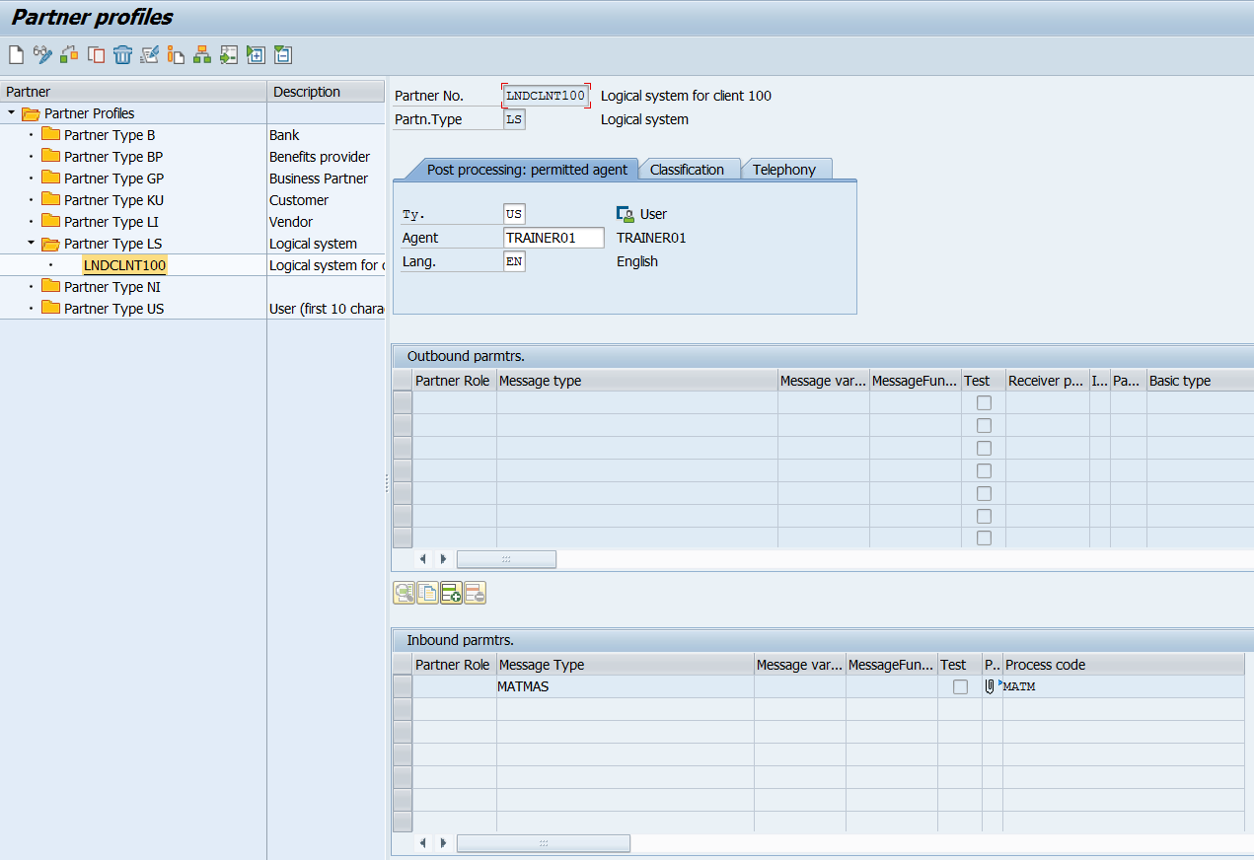
Partner Profiles
Inbound parameter

Slide 33
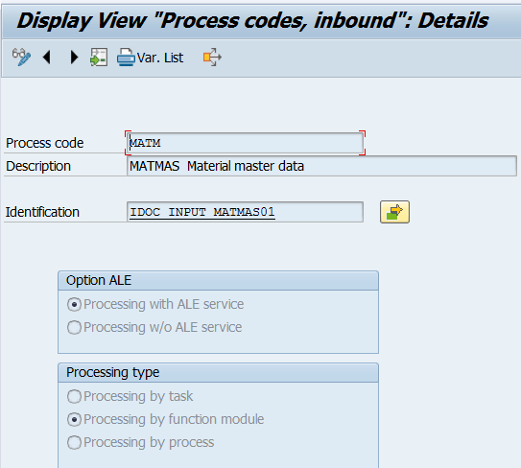
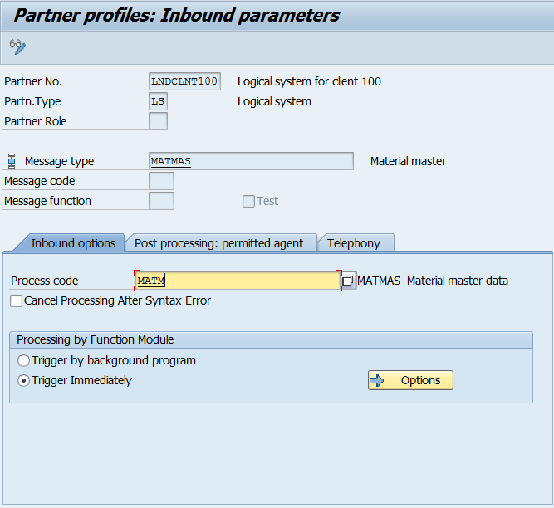
Partner Profiles -Inbound
The following settings are specified in the inbound parameters :
The Process code that invokes the posting function module and creates the document.
Whether the IDoc should be triggered immediately or should be triggered by a background program.

Slide 34
Process Codes
Process Codes are used to identify the function module or API (Application Programming Interface) to be invoked for subsequent processing (Outbound or Inbound) of the business application.
Outbound process code - Outbound process code under Message Control, generated the IDoc in the IDoc Interface. The process code determines the relevant function module. (TCode – WE41)
Inbound process Code - names the function module or workflow which reads the IDoc data and transfers the data to the application document. (TCode – WE42)
Outbound process codes are stored in table TEDE1, while inbound process codes are stored in TEDE2

Slide 35
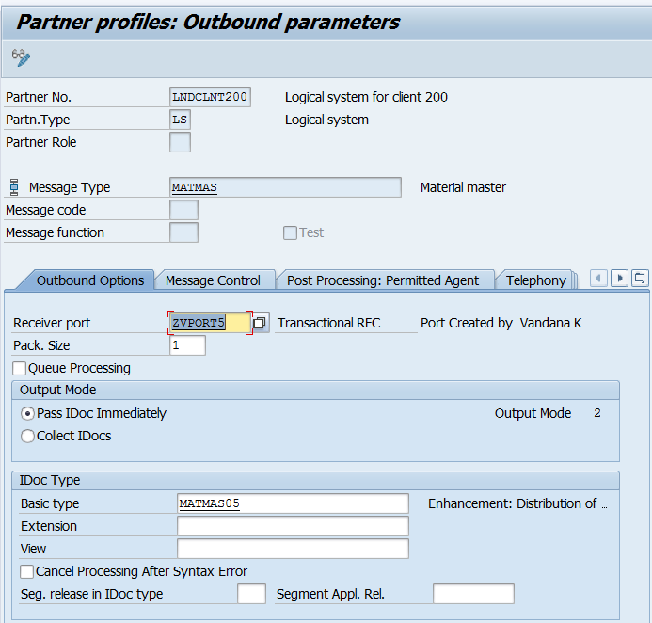
Partner Profile – Outbound
For a receiver partner system (outbound parameters are filled in), following settings are specified in the partner profile:
The receiver port to which the data will be sent.
The sending method: one IDoc at a time or by packets.
The IDoc type that will be sent to that partner. For a given message type, the IDoc type sent may vary depending on the receiver system.

Slide 36
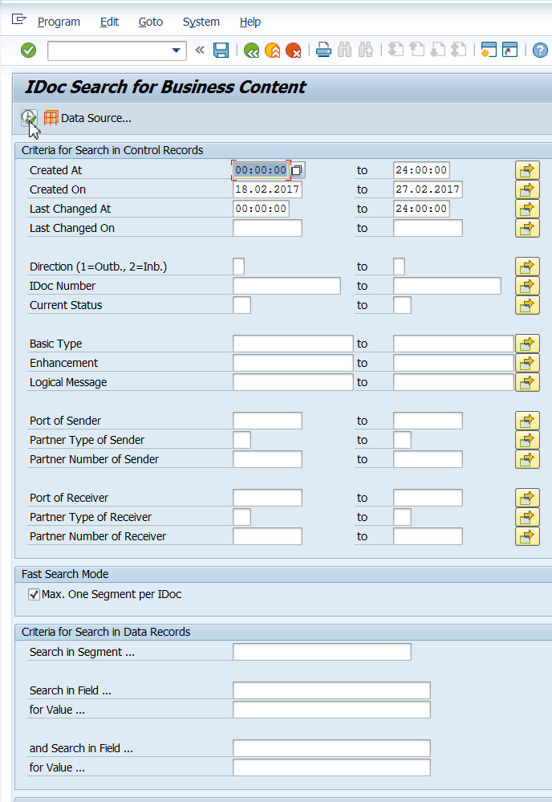
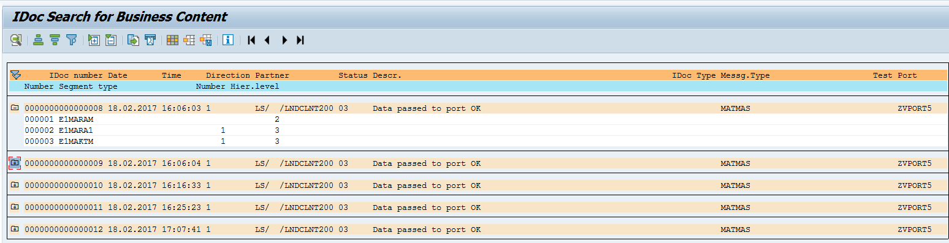
IDoc Monitoring
List IDoc using WE09, We can search with the help of Segment / Field values

Slide 37
Demo: IDoc Monitoring using WE09

Slide 38
Demo: IDoc Monitoring using WE02

Slide 39
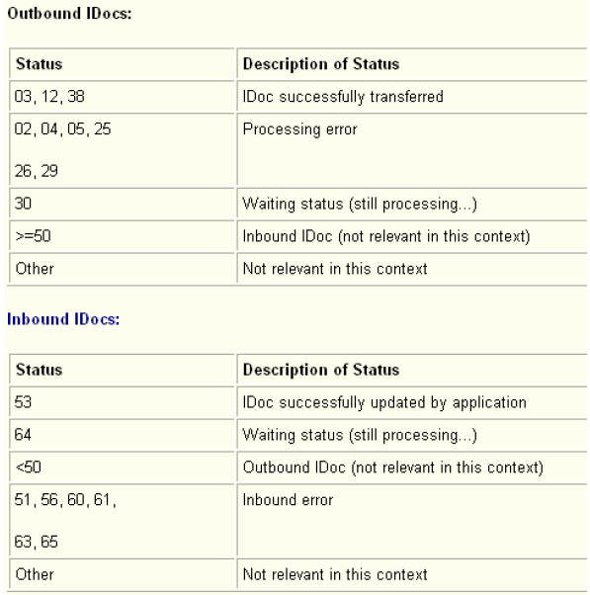
Inbound and Outbound Status

Slide 40
ALE Monitoring
Status Monitor for ALE Messages can be seen using TCode – BD87
If any error is seen in IDoc processing status in ALE layer, we can rectify the error and reprocess the communication idoc rather than triggering the application transaction repeatedly .

Slide 41
Demo: ALE Monitoring using BD87

Slide 42
Testing Tools
You can use the test tool to generate an IDoc manually and send the IDoc for either inbound or outbound processing.

Slide 43
Demo: WE19

Slide 44
IDoc Documentation
TCode WE60 is used for Documentation for IDoc types.

Slide 45
Demo: WE60

Slide 46
Area Menu
Tcode WEDI is the workbench for EDI development.

Slide 47
Demo: WEDI

Slide 48
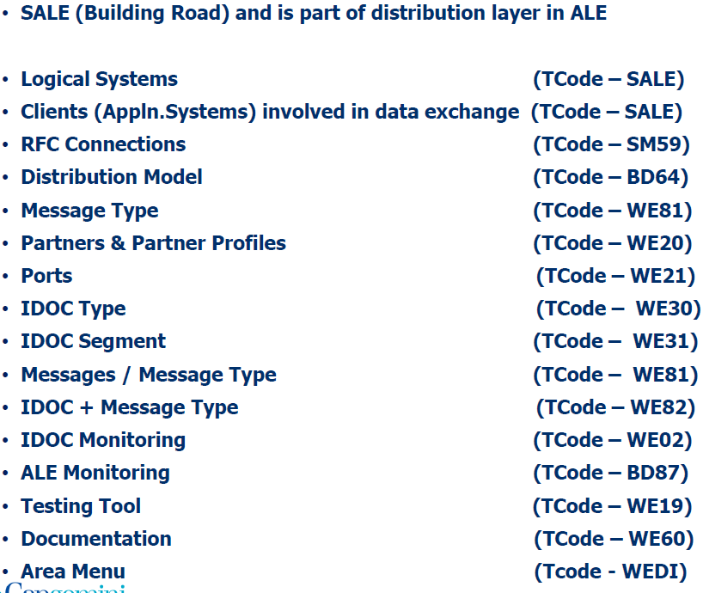
Summary of TCodes

Slide 49
IDoc Processing
The IDoc Interface supports three types of data flow with the external system.
Outbound processing - Idocs are transferred to a receiving system from the SAP System.
Inbound processing - Idocs are transferred to the SAP System from a sender system.
Status processing - The follow-on system confirms the processing status of outbound Idocs to the SAP System.

Slide 50
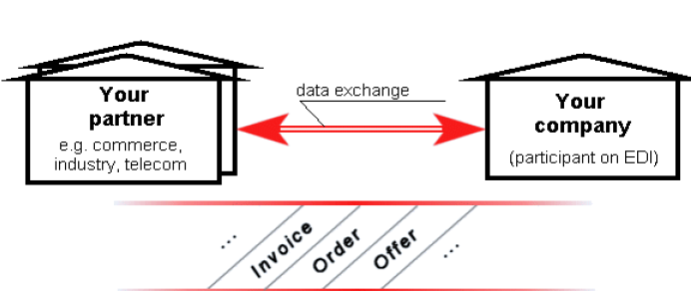
Typical EDI Scenario
What does EDI mean ?
EDI (Electronic Data Interchange) means exchange of business documents among companies using electronic communication systems. Trading partners - The parties who exchange EDI transmissions.

Slide 51
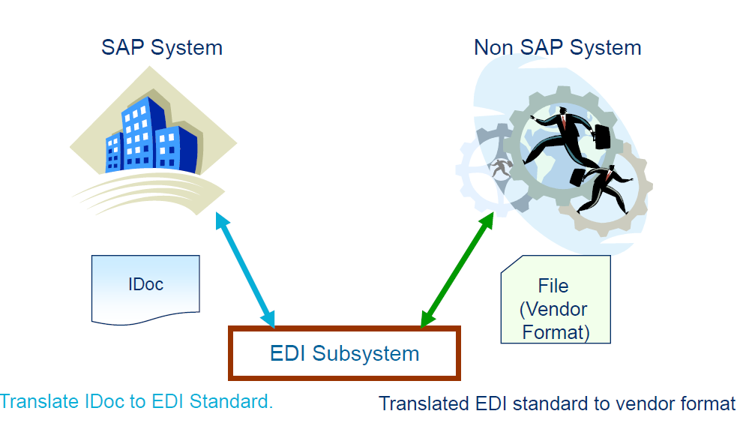
EDI (Electronic Data Interchange)

Slide 52
EDI (Electronic Data Interchange)
EDI is a standard format for exchanging business data between any 2 systems on different networks .
In case of SAP , Idocs from SAP can be converted to EDI format. This is useful and is widely used for communication with customers and vendors (non-SAP ) who do not understand Idoc format .
EDI subsystem is needed for communication between 2 systems. This translates the data into standard EDI format that is understood by receiver / sender system.
EDI uses either ANSI X12 or EDIFACT as standard formats in the data exchange.
In SAP communicating partners are not defined as logical systems for EDI. They have partner types like KU-Customer, LI-Vendor etc...which uses a file port.

Slide 53
EDI vs. ALE
The main difference occurs at the communication Level.
EDI process transmits IDocs to an EDI subsystem using flat file format.
The ALE process transmits IDocs to an SAP system via memory using Asynchronous communication. No need for subsystem.

Slide 54
Summary
In this lesson, you have learnt:
The concept of ALE and IDocs.
IDoc structure and its role in Data communication
Basic Outbound Processing of IDoc.
Basic Inbound Processing of IDoc.
What is EDI

Slide 55
Review Question
Question 1:The _______ is used for Documentation for IDoc types.
Question 2: ____ is TCode that is used for all ALE customizing .

